Slide 1



UNH SEDS
CEPS Engineering Organization
High Power Rocketry
University of New Hampshire
Students for the Exploration and Development of Space

Slide 2

University of New Hampshire
Students for the Exploration and Development of Space

Slide 3
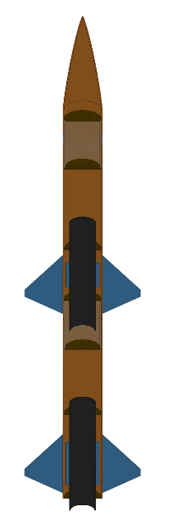
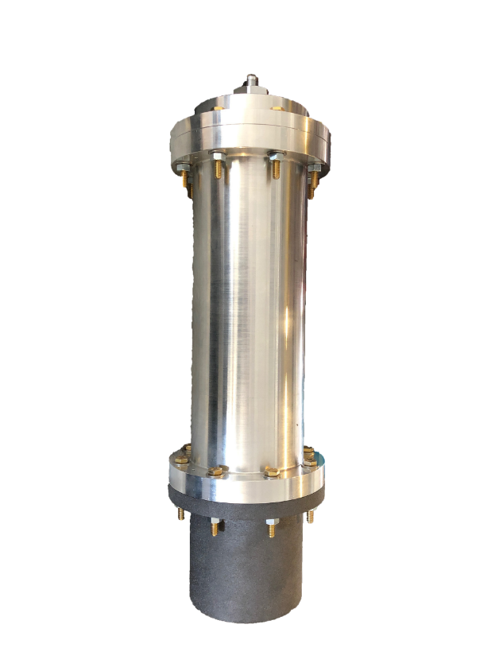


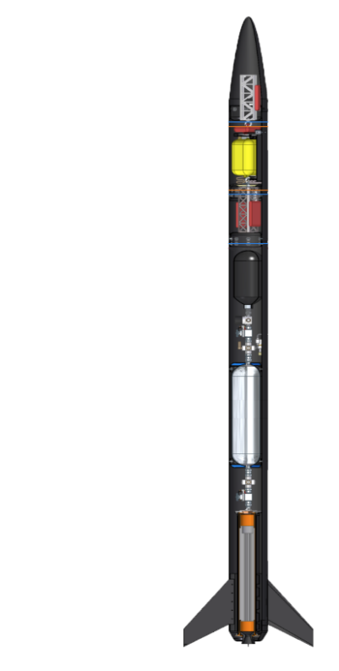




UNH SEDS Three-Year Plan
Year Three
2019-2020
Year One
2017-2018
Year Two
2018-2019
Runaway
Rocket Building
Simulating
Launching
Optimizing
Hybrid Engine
Design
Manufacture
Test
Hybrid Rocket
Engine Optimization
Rocket Integration
Competition
University of New Hampshire
Students for the Exploration and Development of Space

Slide 4
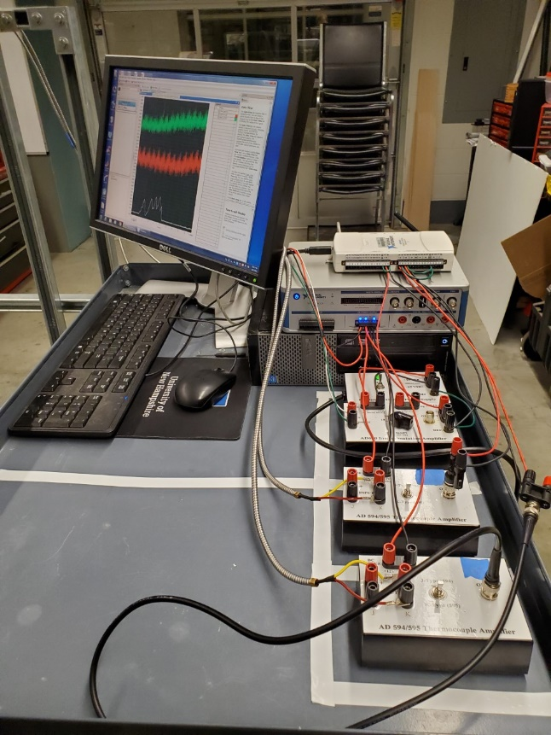
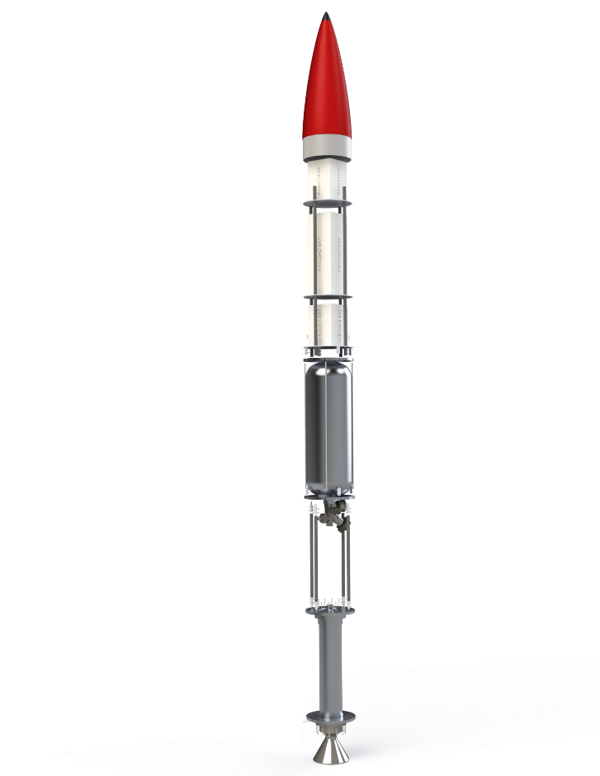
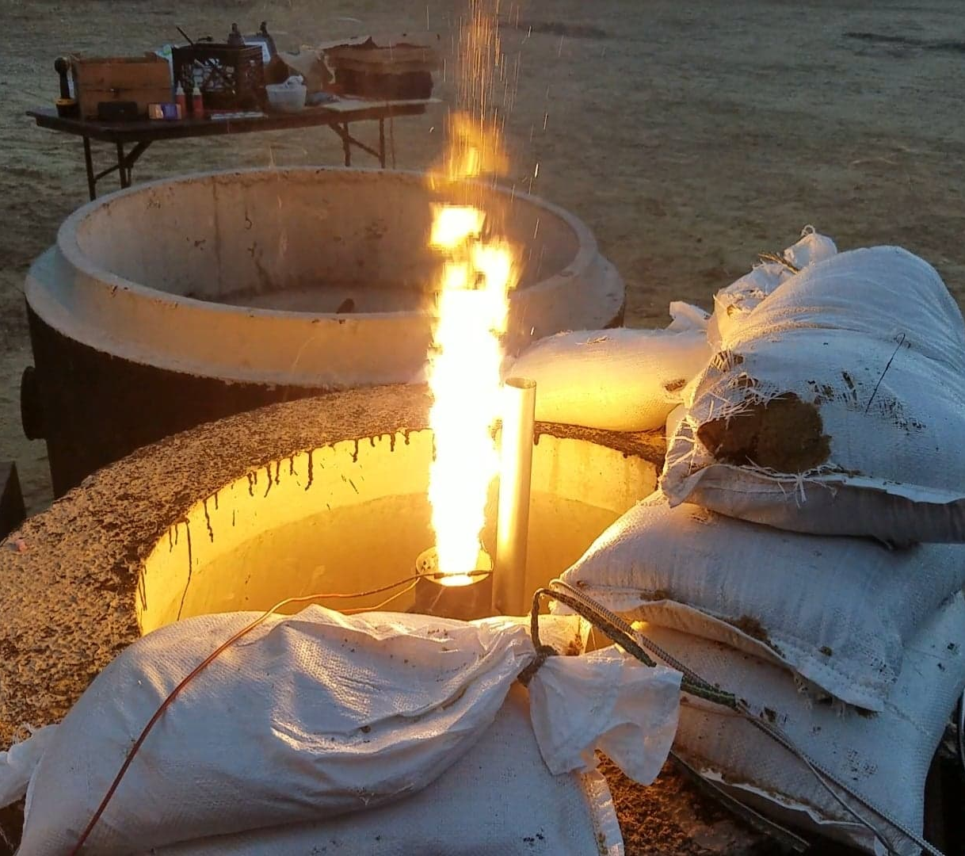
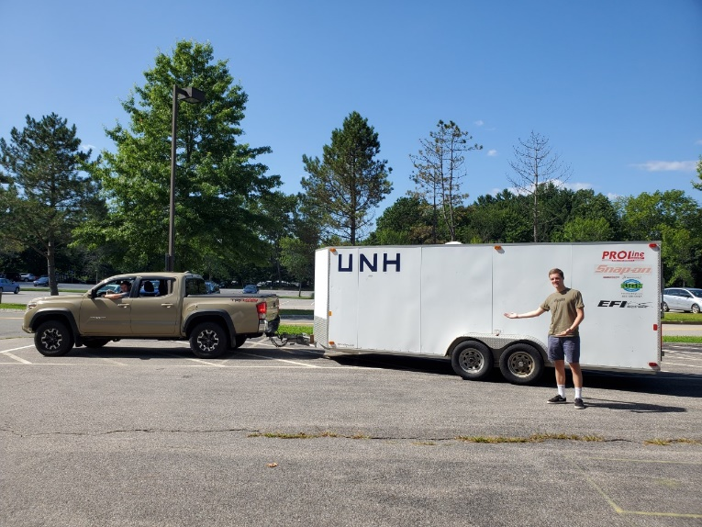
UNH SEDS Spring 2020
Frame Propulsion Avionics Operations
University of New Hampshire
Students for the Exploration and Development of Space

Slide 5

UNH SEDS in the future
Conferences:
Spaceport America Cup
June 2020 in New Mexico
Target Apogee 10,000 ft.
SpaceVision
October 2020 in Texas
Annual Conference to Speak and Connect with many Aerospace Companies
Future Work:
Thrust vectoring system
Satellite research
Whatever direction you want to take it!
University of New Hampshire
Students for the Exploration and Development of Space

Slide 6





Why Join UNH SEDS?
Passionate about Engineering and want to Apply your Knowledge?
Interested in the Aerospace Industry?
Looking to be Involved with an Organization at UNH?
Wondering what to do for a Senior Project?
University of New Hampshire
Students for the Exploration and Development of Space

Slide 7


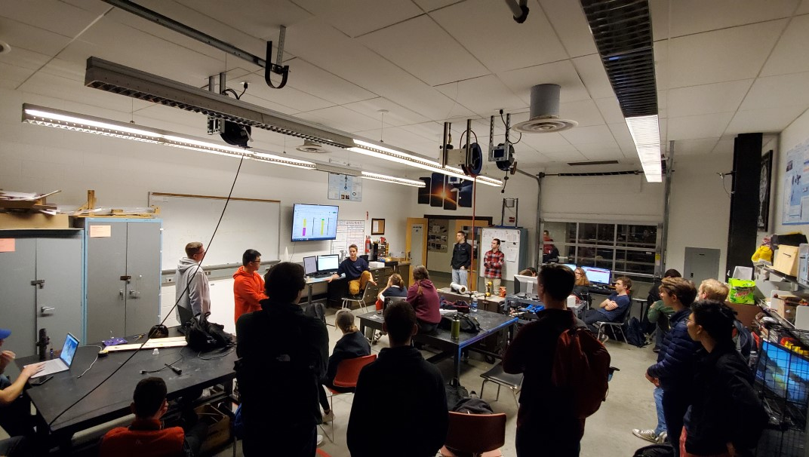
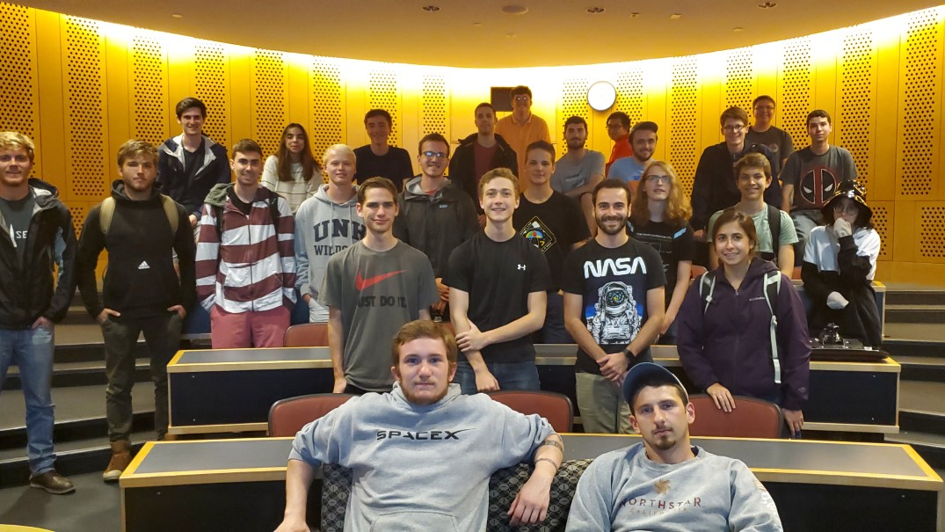
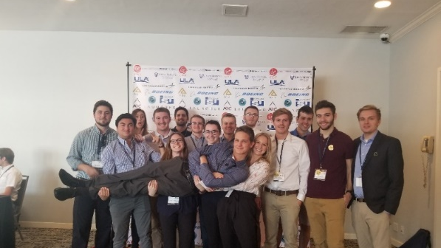
Join us!
Informational Meeting: Mon Jan 27th at 8pm in Kings S172
University of New Hampshire
Students for the Exploration and Development of Space
Notes:
EE major too

